Slide 1
Facial Recognition based Attendance management system
CMPE-281 Project-2
Presented By : Geek Squad
Team:
Mohit Mahendra Singhvi
Mohaimin Iqbal Gazi
Kushal Sai Vema
Manikanta Nynala

Slide 2
Problem Statement
Traditional methods such as paper sign-in sheets and badge scanners, are time-consuming, inefficient, and prone to errors.
The Students or Employees must carry their ID card for barcode or NFC based authentication systems, which is an overhead.
Can be misused if lost and cause a security concern.

Slide 3
Proposed Solution
An attendance system where students can mark their attendance by just pointing their face in front of the camera.
The Attendance data of all the sessions of the courses will be available to the professors on a dashboard.
This uses facial recognition technology backed by Amazon Rekognition API.
The Project Architecture is built entirely on AWS and deployed on AWS cloud.

Slide 4
Component 1
As a part of component 1, We aimed to design the Project Architecture and build an MVP of the application.
This MVP consists of:
Student registration page: Here Student information will be uploaded along with their photo by an Admin.
Attendance page: Here attendance of the student will be registered through a camera.

Slide 5
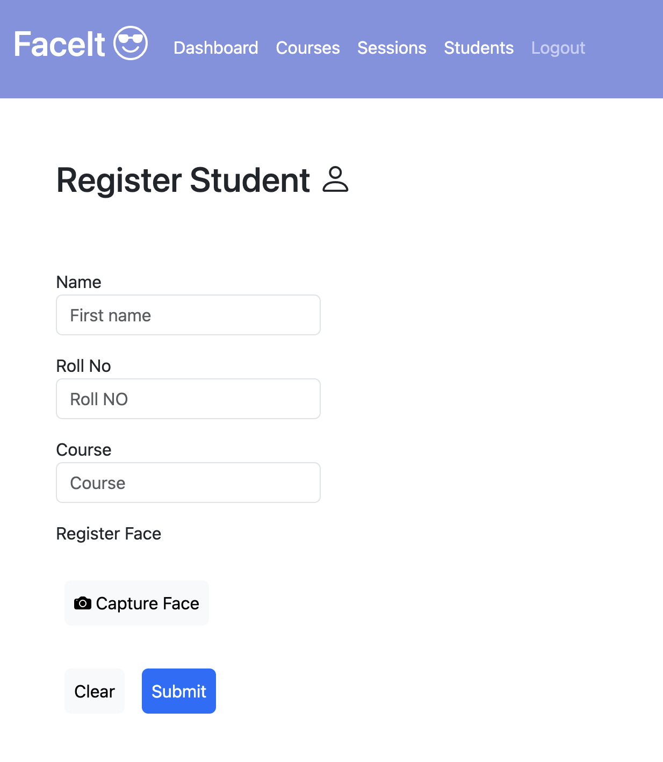
Student Registration Page
On this page,
The Admin will be adding the student information along with the photo of the student.

Slide 6
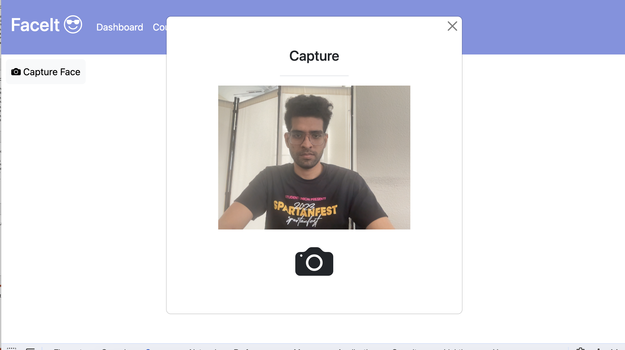
Attendance Page
On this page,
A Student will be capturing the face for attendance and the system will mark the attendance if the student has been registered

Slide 7
Rekognition APIs used
indexFaces
This API is used to index the face of a student in the Amazon Rekognition collection.
searchFacesByImage
This API is used to search the collection and check if the face in a given image matches any of the faces in the collection.

Slide 8
Architecture
The project is built as a 3-tiered architecture.
The User interface of the application is built on Angular.
The UI is backed by REST APIs built on Node.js
RDS MySQL is used for storing student, session and attendance information.
Amazon Cognito is used for user authentication.

Slide 9
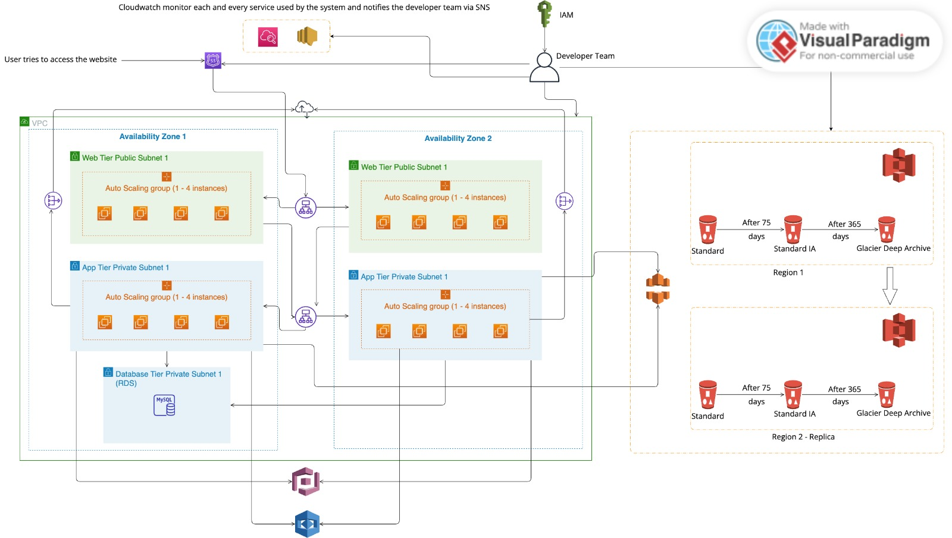
Architecture Diagram

Slide 10
Links
Demo Link https://drive.google.com/file/d/1m_XLIED0klvWmQNiVhSXKy174bQBtaUx/view?usp=sharing
UI Repository: https://github.com/MohitSinghvi/faceId-attendance-ui
Backend Repository: https://github.com/MohitSinghvi/faceId-attendance-backend

